Slide 1



qBraid
Cloud-based platform for quantum computing

Slide 2


What can qBraid offer for your QC needs?
qBraid
| LEARN
Launch quantum computing courses for a fraction of the cost and overhead

Slide 3


What can qBraid offer for your QC needs?
qBraid
qBraid
| LEARN
| LAB
Launch quantum computing courses for a fraction of the cost and overhead
Get started on research programs in under 5 minutes with world class technology
4

Slide 4

What can qBraid offer for your QC needs?
qBraid
qBraid
qBraid
| LEARN
| LAB
| SDK
Launch quantum computing courses for a fraction of the cost and overhead
Get started on research programs in under 5 minutes with world class technology
Try the world’s first transpiler between IBM Qiskit, Pennylane, Amazon Braket, Cirq and Pyquil
4

Slide 5

What can qBraid offer for your QC needs?
qBraid
qBraid
qBraid
qBraid
| LEARN
| LAB
| SDK
| RESEARCH
Launch quantum computing courses for a fraction of the cost and overhead
Get started on research programs in under 5 minutes with world class technology
Try the world’s first transpiler between IBM Qiskit, Pennylane, Amazon Braket, Cirq and Pyquil
We develop the quantum computing applications of tomorrow
4

Slide 6
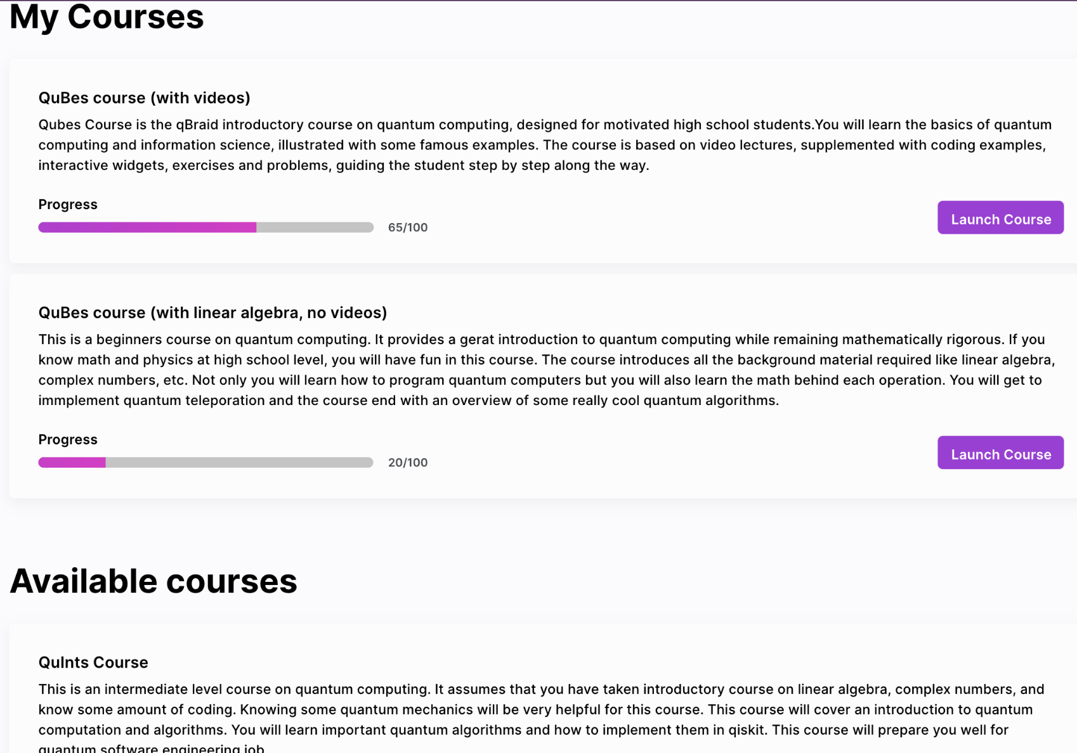
qBraid
| LEARN
Launch quantum computing courses for a fraction of the cost and overhead
5

Slide 7
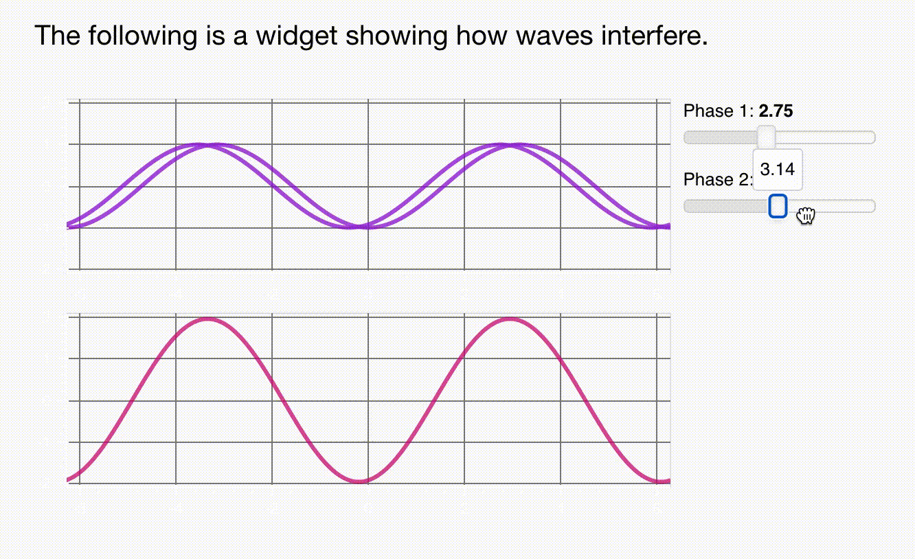
qBraid
| LEARN
Simply Teach Quantum Computing Courses
With our all in one platform, users can learn quantum computing using interactive widgets, runnable code cells, and videos all in a Medium©-esque style that students are familiar with
6

Slide 8
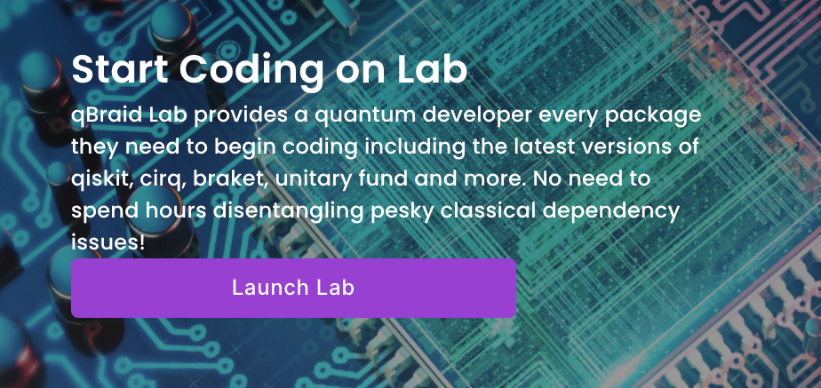
qBraid
| LAB
Get started on research programs in under 5 minutes with world class technology
10

Slide 9










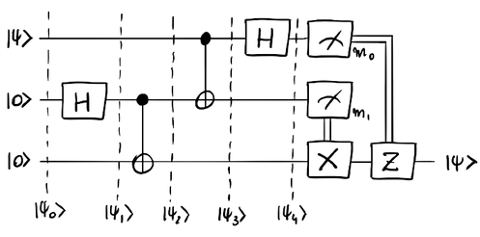



Without qBraid the quantum experience
is costly and complicated.
CLASSICAL STACK
QUANTUM STACK
GET RESULTS
Repeat with another language and device
SETUP ACCOUNT(S) W/ HARDWARE PROVIDER(S)
INSTALL QUANTUM PACKAGES
TEST ON SIMULATOR/ DEVICE
INSTALL AND CONFIGURE IDE
CREATE ALGORITHMS AND CIRCUITS
CREATE VIRTUAL ENVIRONMENT
CHOOSE ONE DEVICE AND LANGUAGE
INSTALL PYTHON AND PACKAGE MANAGER
11

Slide 10

qBraid
| LAB
Cutting edge research
qBraid-Lab is an integrated development environment that provides you and your team the easiest access to all the major quantum SDKs.
12

Slide 11






qBraid
| LAB
65 tutorials from Amazon, IBM, Google, etc
No need to stick to a single quantum SDK.
Get access to all the different quantum hardware on one platform, no cloud service setup necessary
13

Slide 12
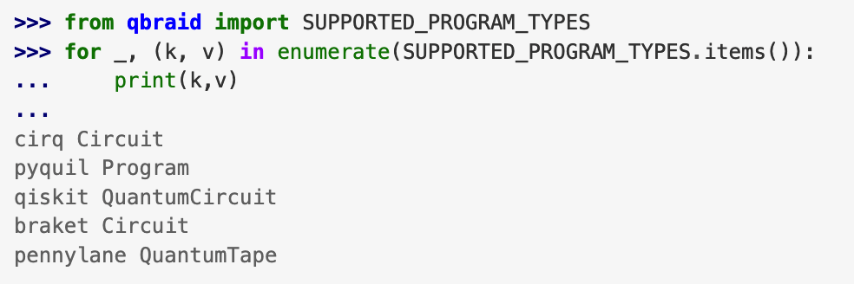
qBraid
|SDK
Try the world’s first transpiler between IBM Qiskit, Pennylane, Amazon Braket, Cirq and Pyquil
18

Slide 13



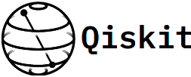





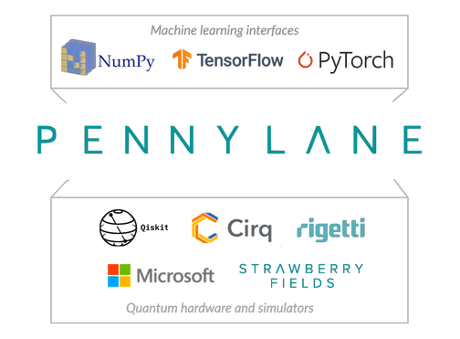



We do not compete, we empower the ecosystem so they can scale faster
qBraid
| SDK
Transpiles and Optimizes
PyQuil
Code in your
favorite language
Get Results on any
provided quantum computer, anywhere
19

Slide 14

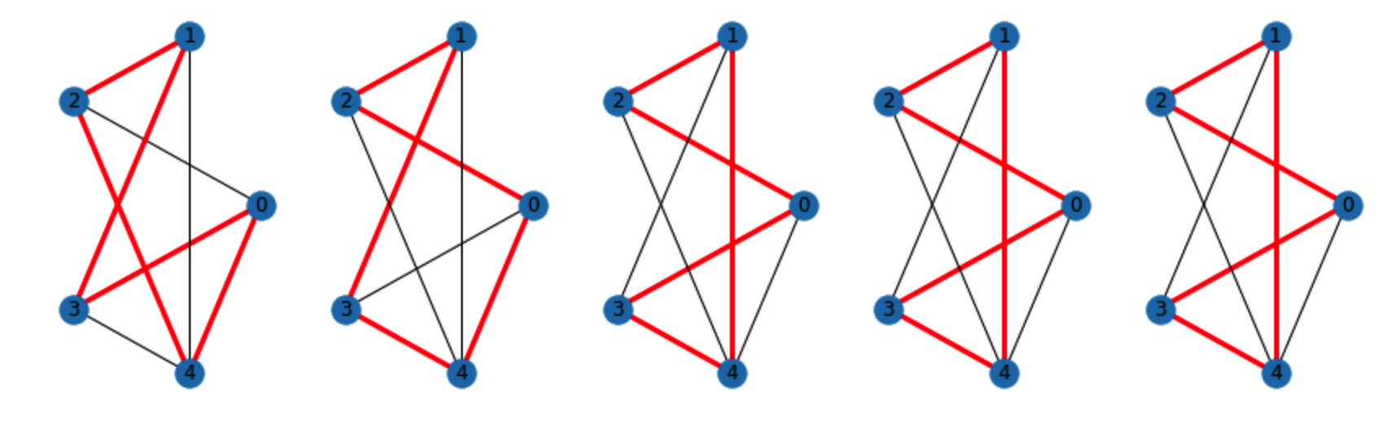
qBraid
|SDK
QCHack Hamiltonian Cycle Challenge Solutions using qBraid SDK:
Leverage the capabilities of multiple frameworks through simple, consistent protocols.
Execute circuits and compare results across backends.
QCHack teams used qBraid-SDK to determine a hamiltonian cycle with Grover’s Search
14 qubit
Grover’s Search
14 qubit
Grover’s Search
8 qubit
Grover’s Search
8 qubit
Grover’s Search
8 qubit
Grover’s Search
20

Slide 15
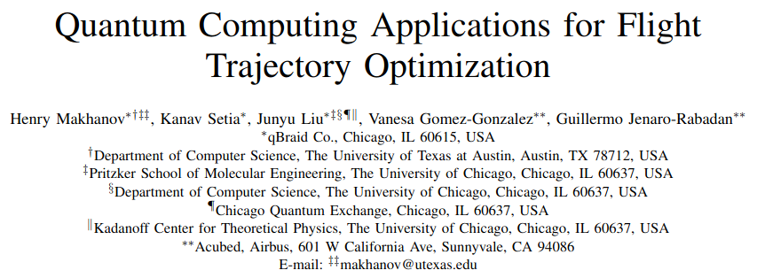
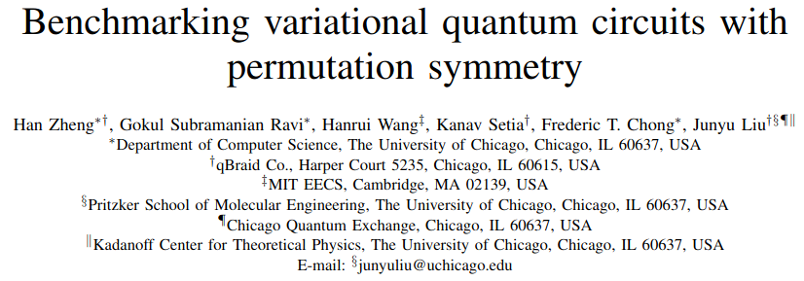
Research with Airbus
qBraid
| RESEARCH
We work with enterprise customers and research institutions to develop algorithms and applications for near-term quantum hardware
Won best paper award at IEEE QCE23
21

Slide 16
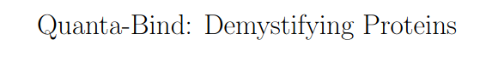
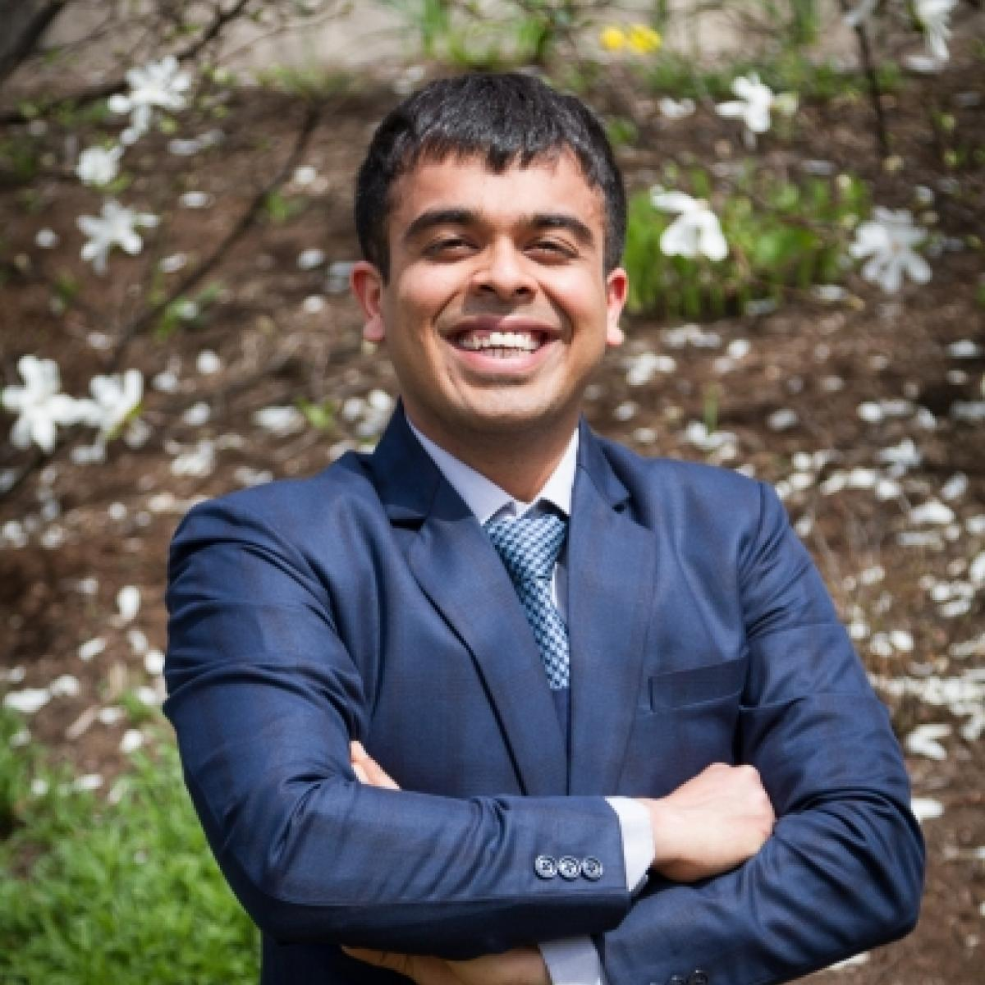
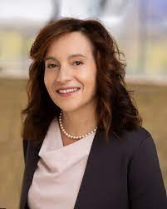
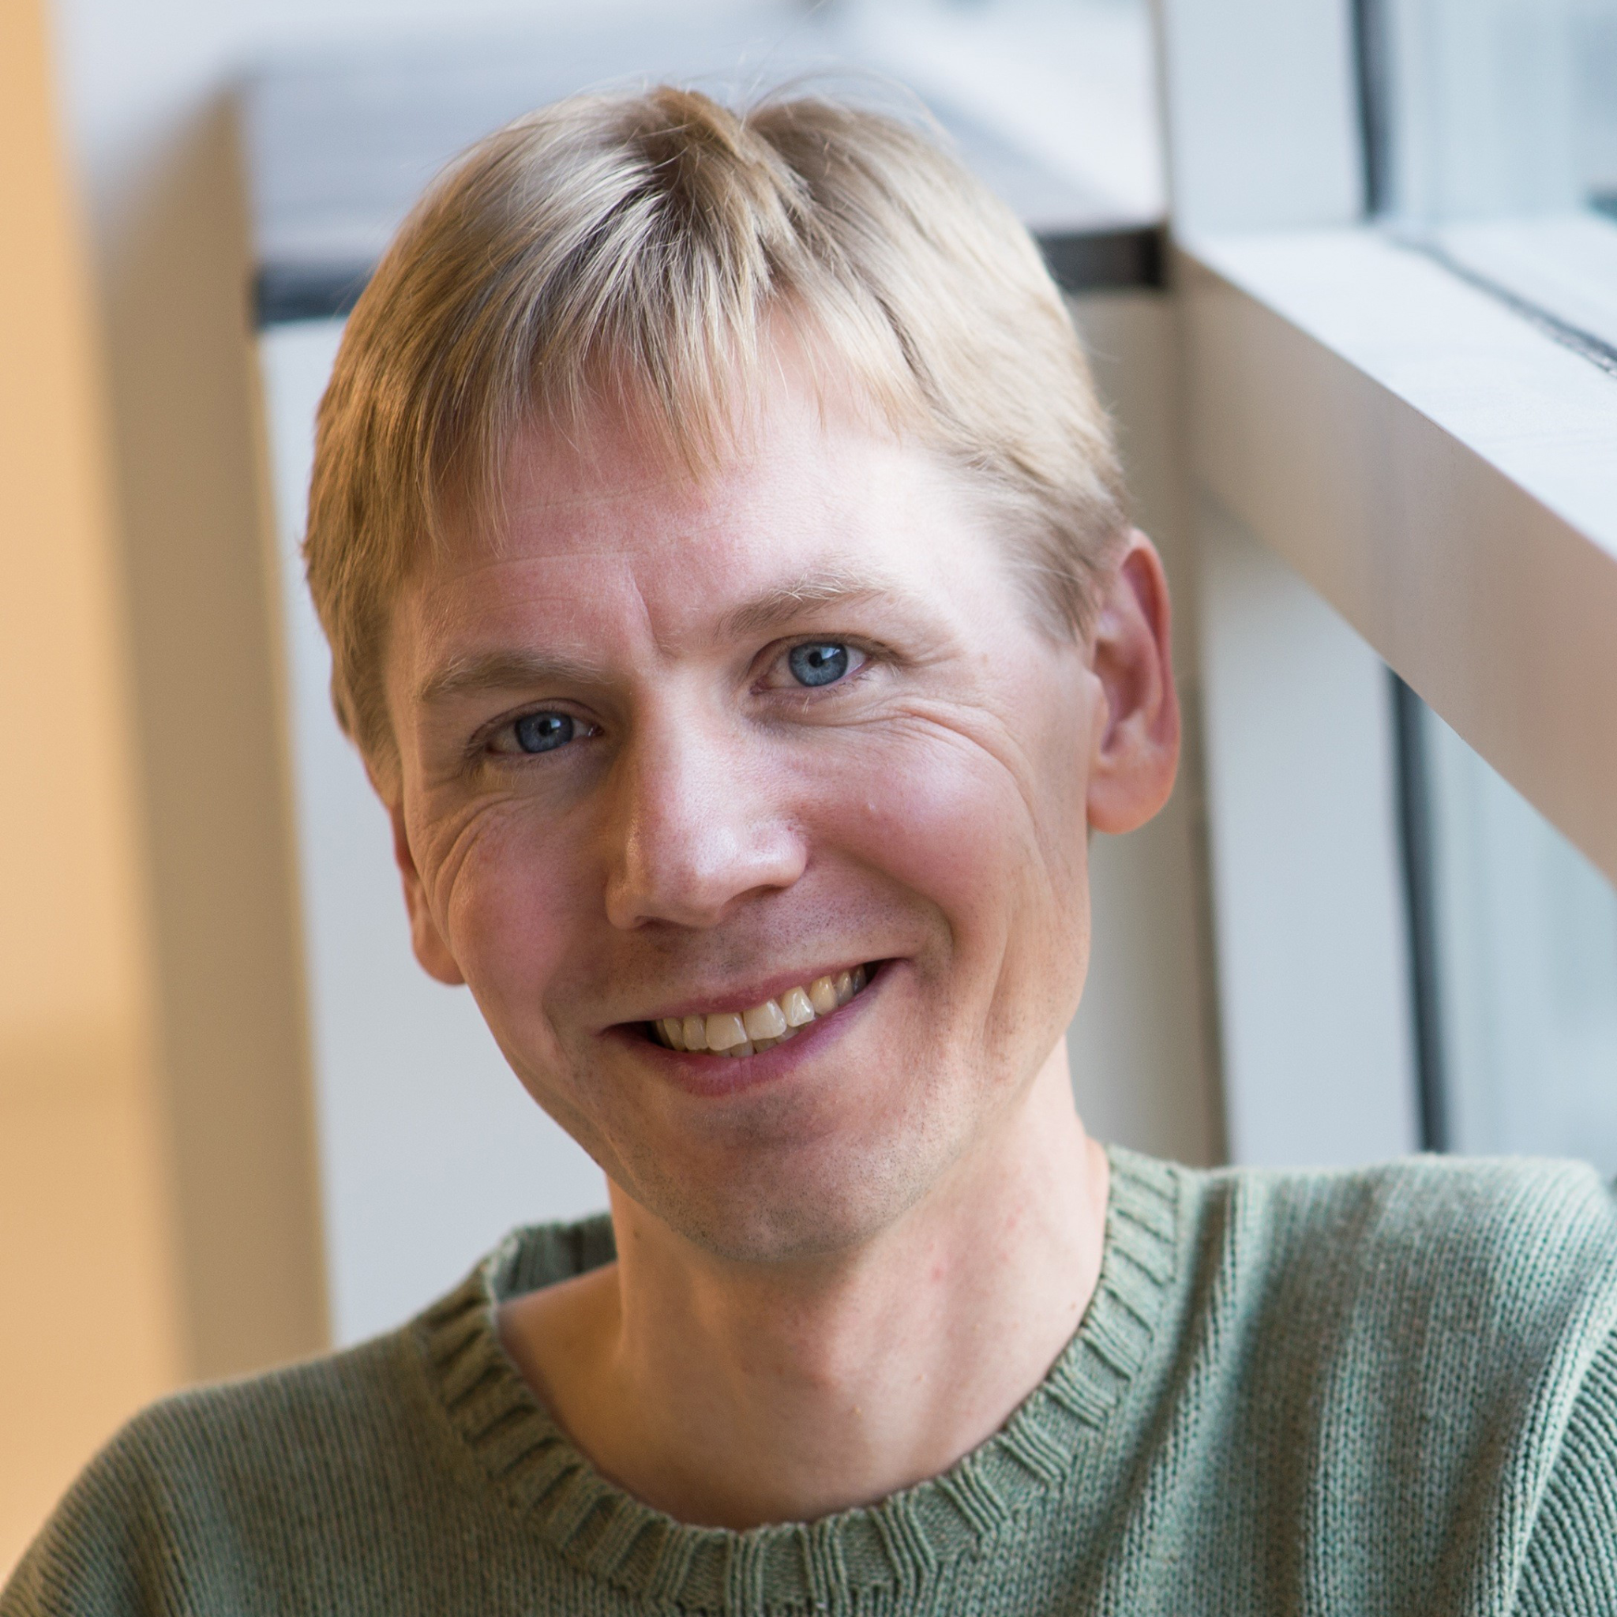
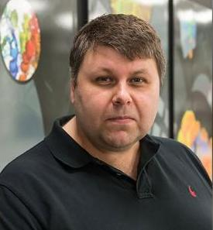
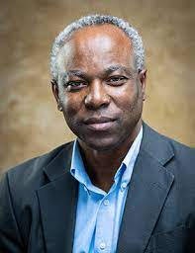
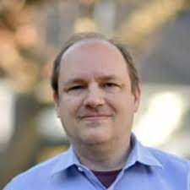
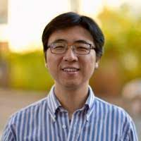
qBraid
| RESEARCH
Coming soon*…
Awarded contract via WellcomeLeap Quantum for Bio program
Kanav Setia,
Cofounder & CEO,
qBraid
Laura Gagliardi,
Richard and Kathy Leventhal Professor of Chemistry and Molecular Engineering,
University of Chicago
Troy Van Voorhis,
Haslam and Dewey Professor of Chemistry,
Massachusetts Institute of Technology
Yuri Alexeev,
Principal Project Specialist - Computational Science,
Argonne National Laboratory
Raymond E Samuel,
Professor,
North Carolina A&T
Nate Gemelke,
Cofounder & CTO,
QuEra Computing
Shengtao Wang,
Quantum Algorithms & Applications Manager,
QuEra Computing
*soon means a minimum of 2.5 years
21

